Slide 1


Edmond Kinnard
US Chronic Diseases

Slide 2

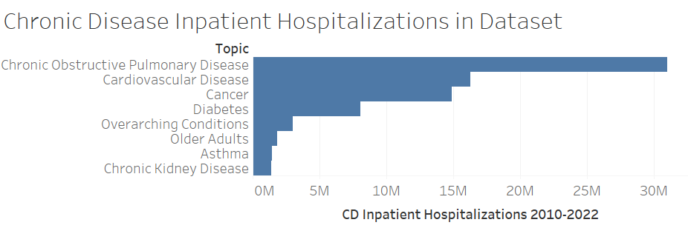
Based on Inpatient Hospitalizations

Slide 3
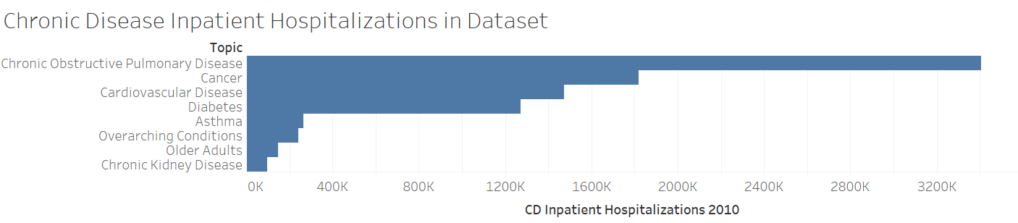
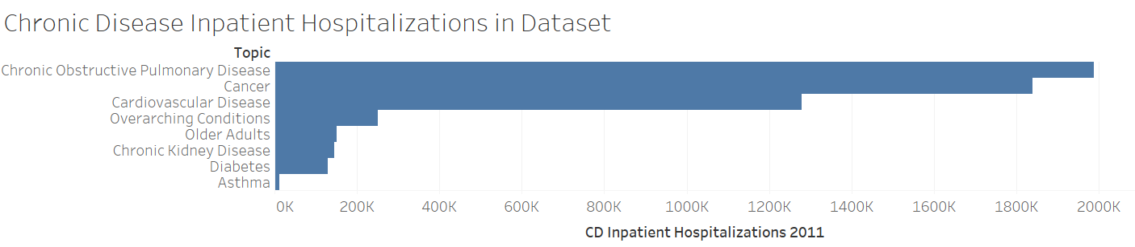
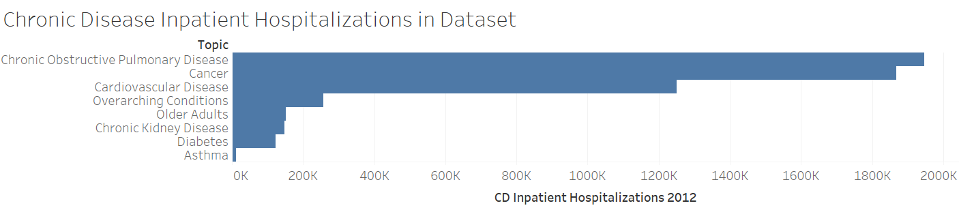
Based on Inpatient Hospitalizations
2010
2011
2012

Slide 4
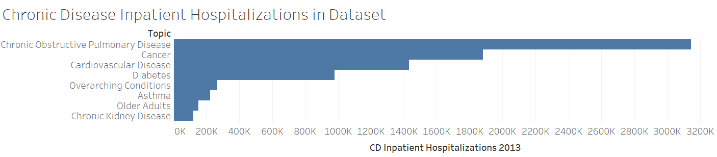
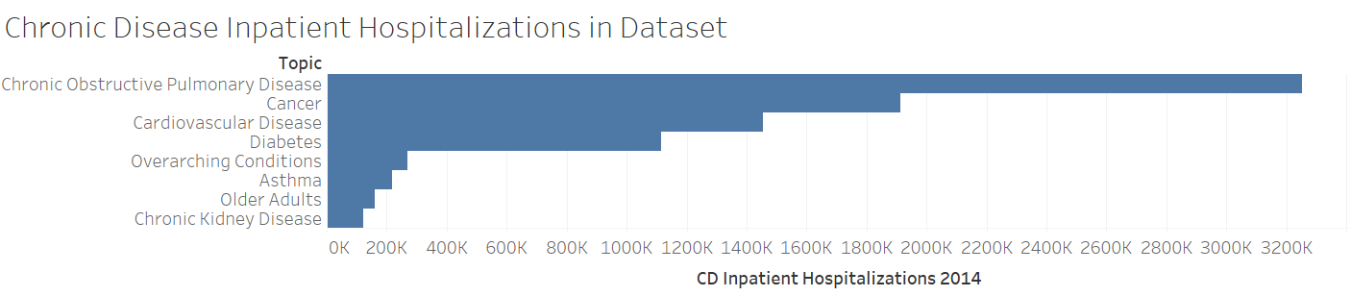
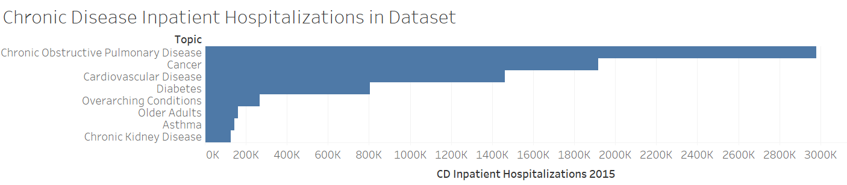
Based on Inpatient Hospitalizations
2013
2014
2015

Slide 5
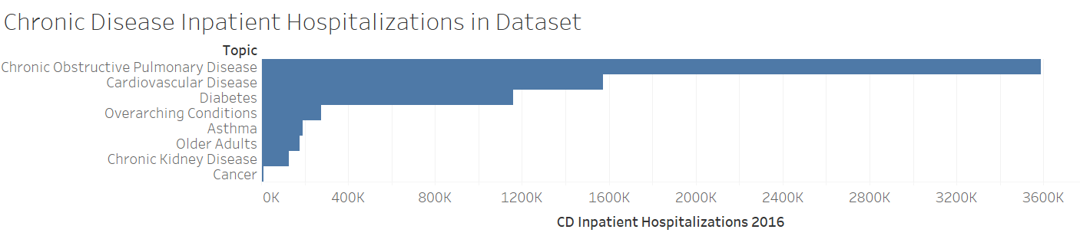
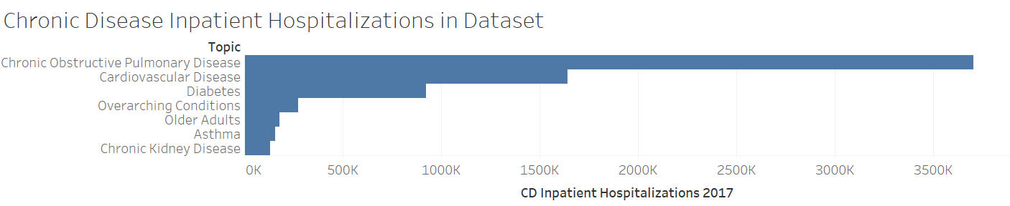
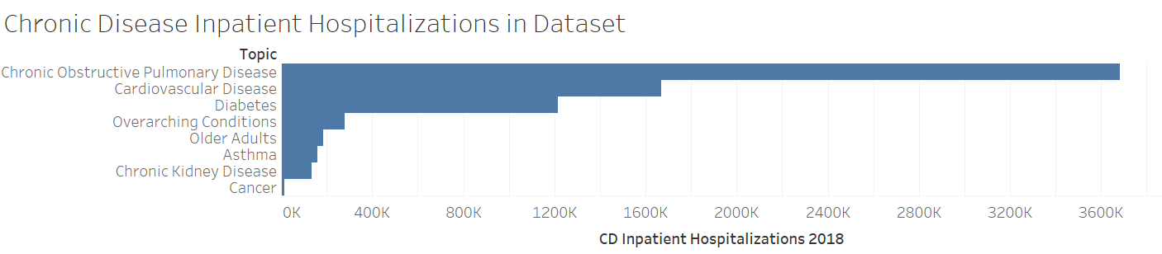
Based on Inpatient Hospitalizations
2016
2017
2018

Slide 6
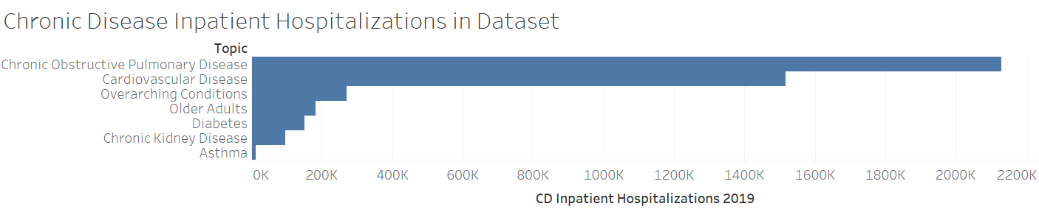
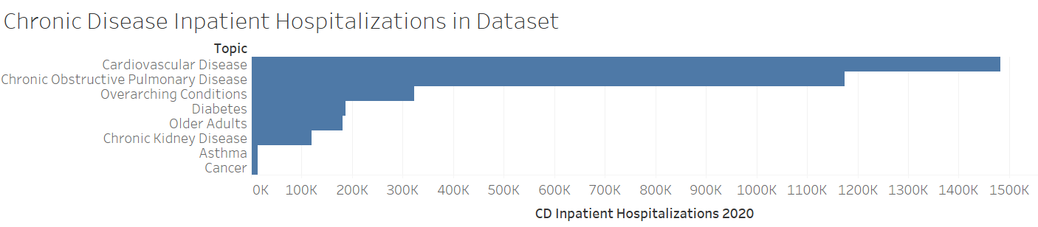
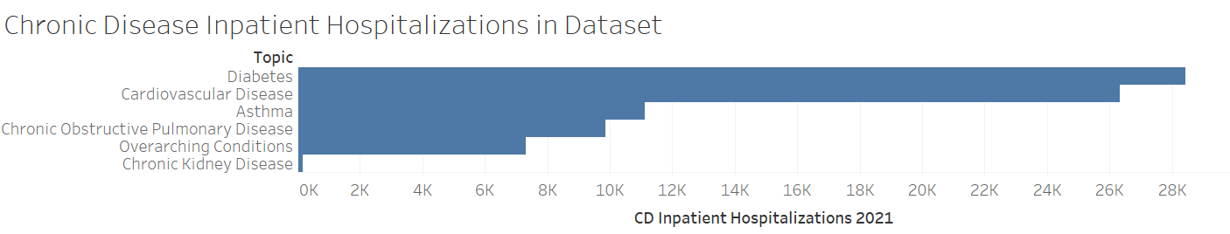
Based on Inpatient Hospitalizations
2019
2020
2021

Slide 7
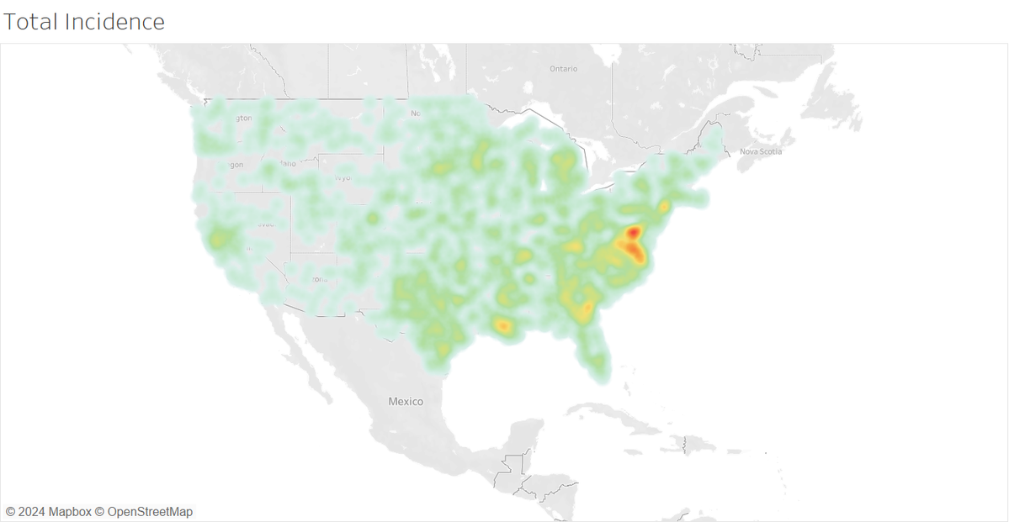
Where are the diseases?
Concentrations:
Washington DC / Virginia
Southeast
Diseases shown:
Chronic Obstructive Pulmonary Disease
Cardiovascular Disease
Cancer
Diabetes
Asthma
Chronic Kidney Disease

Slide 8
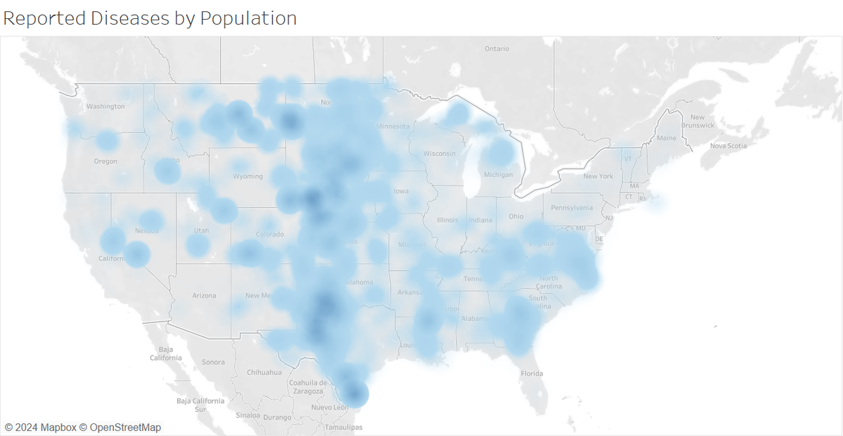
Where are the Diseases by Population?
Concentration:
South Texas through North Dakota
Diseases shown:
Chronic Obstructive Pulmonary Disease
Cardiovascular Disease
Cancer
Diabetes
Asthma
Chronic Kidney Disease
**Incidence divided by local population count

Slide 9
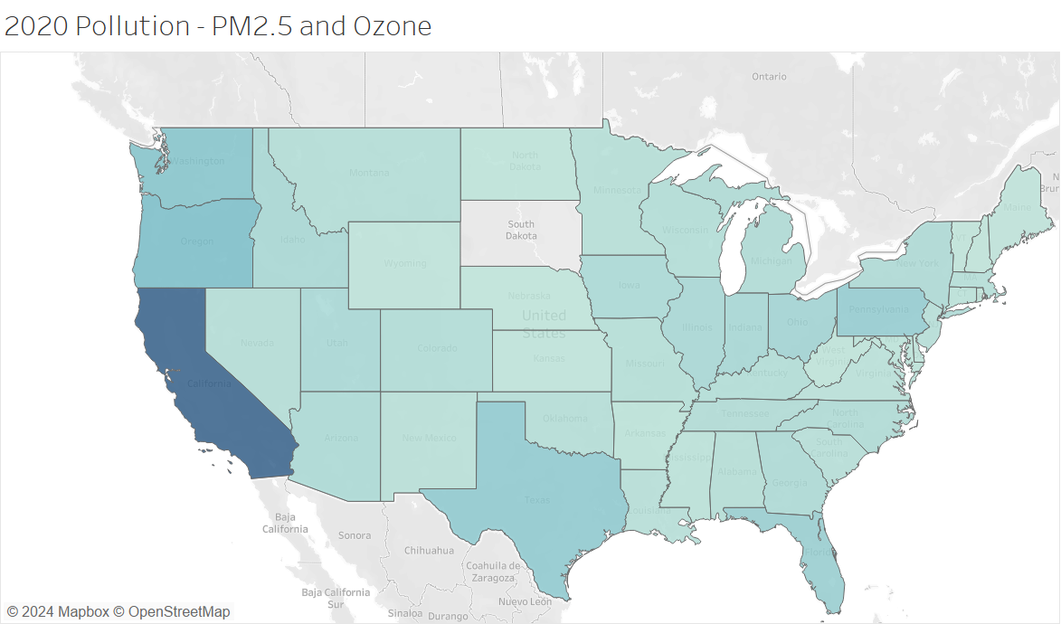
Where is the air pollution?
California
Washington
Oregon

Slide 10
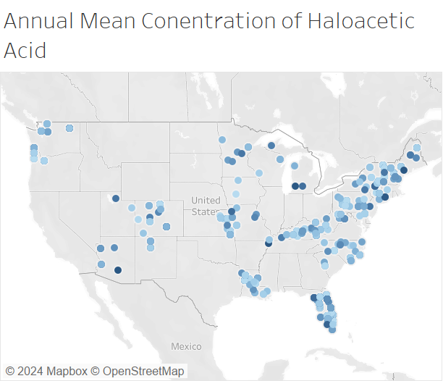
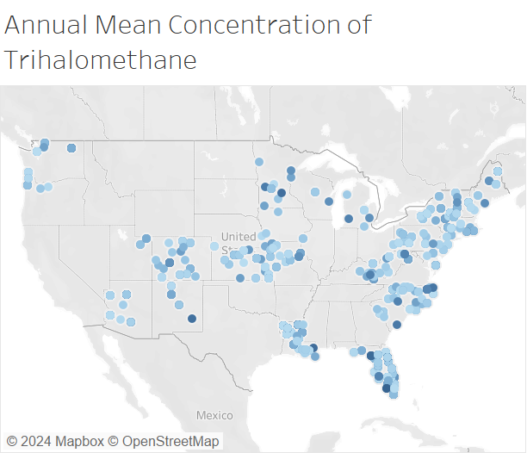
Where is the Water Pollution?
Haloacetic Acid
Trihalomethane

Slide 11
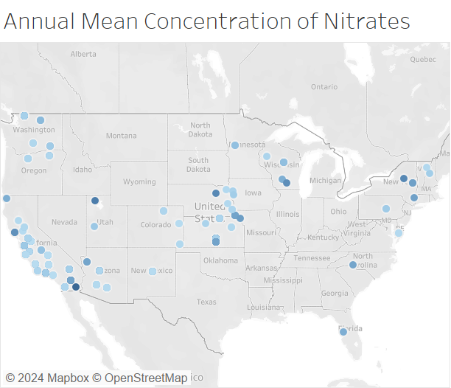
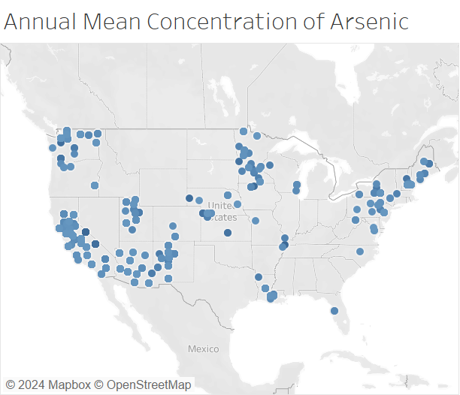
Where is the Water Pollution?
Nitrates
Arsenic

Slide 12
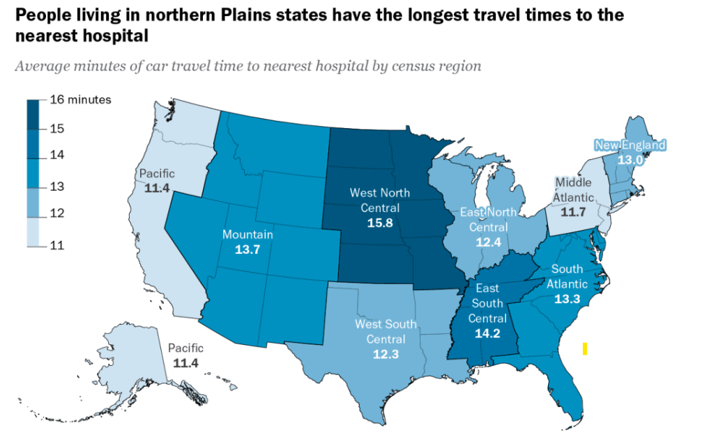
Access to Healthcare by Distance to Nearest Hospital:
Possible that more difficult access to hospitals/specialists in plains area preventing patients from catching diseases in early phase.
*Pew Research

Slide 13

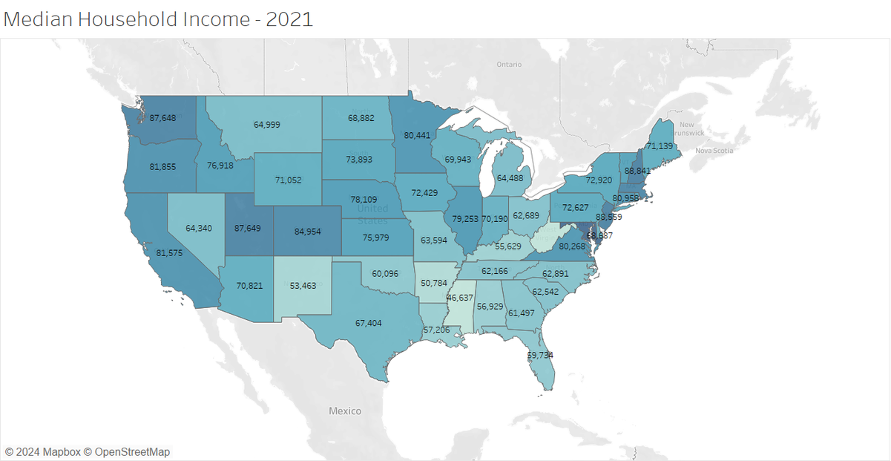
Where Is the Money?

Slide 14
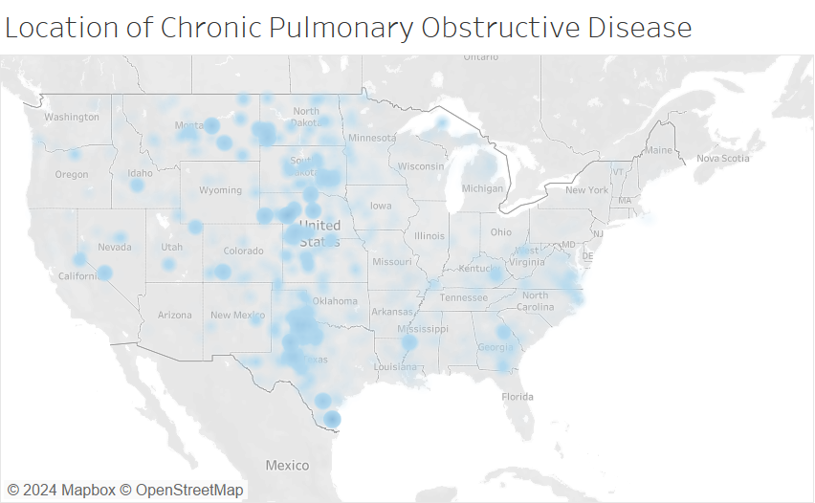
Where i s Chronic Obstructive Pulmonary Disease by Population?
Concentration:
South and East Texas through North Dakota
According to American Lung Association:
Rates of COPD are 60% higher in rural areas compared to urban.
Smoking
Access to healthcare
NOTE: Texas rates are low in major cities
**Incidence divided by local population count

Slide 15
Current Smokers - State Rankings
Rank | State | Current Smokers | Current Smokers Percentage
12 | Oklahoma | 576,977 | 20.10%
13 | Michigan | 1,441,675 | 19.30%
14 | South Dakota | 124,347 | 19.30%
15 | South Carolina | 711,229 | 18.80%
16 | Pennsylvania | 1,837,177 | 18.70%
17 | Wyoming | 82,278 | 18.70%
18 | North Dakota | 103,343 | 18.30%
19 | Nevada | 394,177 | 17.60%
20 | Georgia | 1,307,100 | 17.50%
21 | New Mexico | 264,465 | 17.50%
22 | Kansas | 360,137 | 17.40%
23 | Maine | 179,036 | 17.30%
24 | Montana | 138,198 | 17.20%
5 out of 6 in COPD mid-country cluster are above average in smoking rates by population

Slide 16

In Conclusion:
Chronic diseases (Due in large part to COPD) seem to favor the Mid-West:
-Rural
-Increased distance to hospitals
-Above-Average prevalence of smoking

